Slide 1
Multi-level sentiment analysis system
Karam Ayman Saidam
Rahaf Rami Almasri

Slide 2
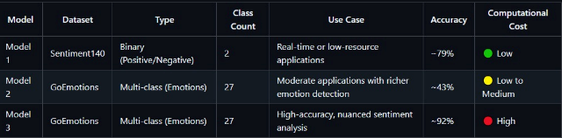
Model Overview

Slide 3
first model: Logistic Regression
Dataset: Sentiment140
Task: Binary sentiment classification
Model: TF-IDF + Logistic Regression
Best for:
Real-time filtering
Mobile/Edge devices
Accuracy: ~77% , ✅ Fast and lightweight, ❌ Cannot detect sarcasm or subtle emotions

Slide 4
Model 2 – XGBoost Classifier
Dataset: GoEmotions
Task: Classify text into 27 emotion categories
Model: TF-IDF + XGBoost
Best for:
Chatbots
Product feedback analysis
✅ More expressive than binary
❌ Still lacks deep understanding of context

Slide 5
Model 3 – Fine-Tuned BERT
Dataset: GoEmotions
Task: Deep emotion classification
Model: Fine-tuned BERT
Best for:
NLP research
High-stakes applications
✅ Captures sarcasm, nuances, and complex context
❌ High inference/training cost, needs GPU

Slide 6
Common Pipeline
All models follow this general pipeline:
Preprocessing
Stopword removal
URL & mention stripping
Punctuation cleanup
Lemmatization
Vectorization
TF-IDF for Models 1 & 2
Training
Evaluation
Prediction

Slide 7
Future Improvements
✅ Deploy live web demo
✅ Add model ensemble for better accuracy
✅ Add sarcasm detection layer

Slide 8
we used in first two models ml , and in third one DL Approach
🔍 Comparing ML vs DL Approaches in This Project

Slide 9
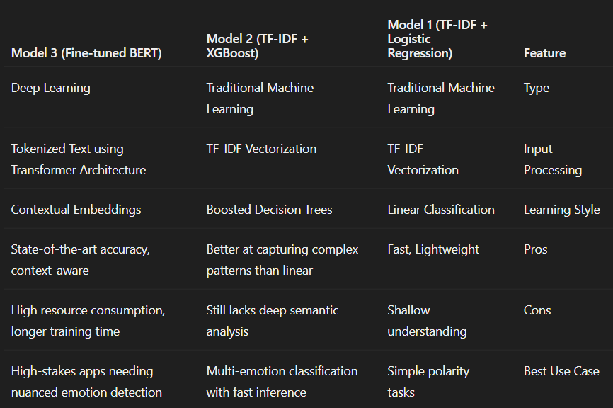

Slide 10
for trying it
full code:
Sentiment analyzer - ML Project.ipynb - Colab

